Slide 1

R&D SPEND BENCHMARKING PRESENTATION
Presented by Derrick Anunda

Slide 2
Problem Statement
Conducting a benchmark analysis of R&D spending among leading companies to assist Hydrizon in identifying percentage of an optimal R&D expenditure level.
Objective
    To provide Hydrizon with data-driven insights and recommendations on the optimal R&D spend level to support their strategic decision-making and innovation efforts.

Slide 3
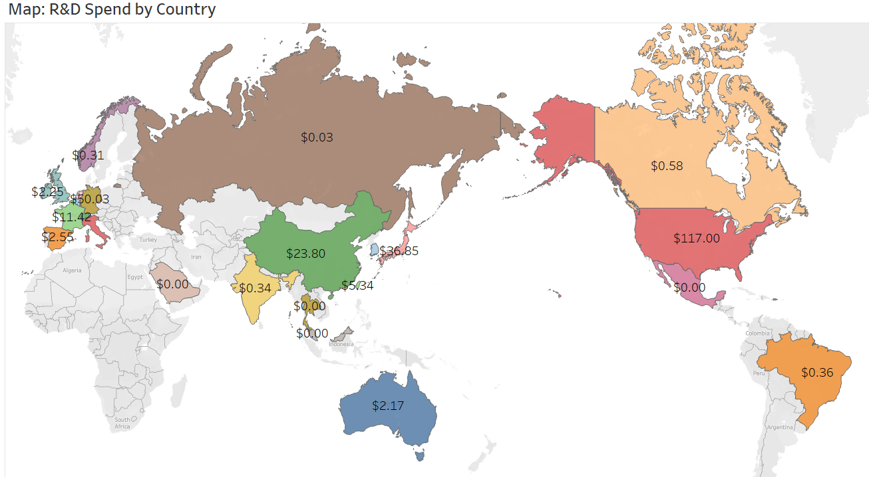
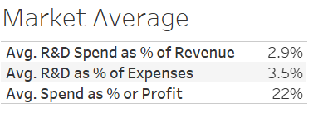

Slide 4
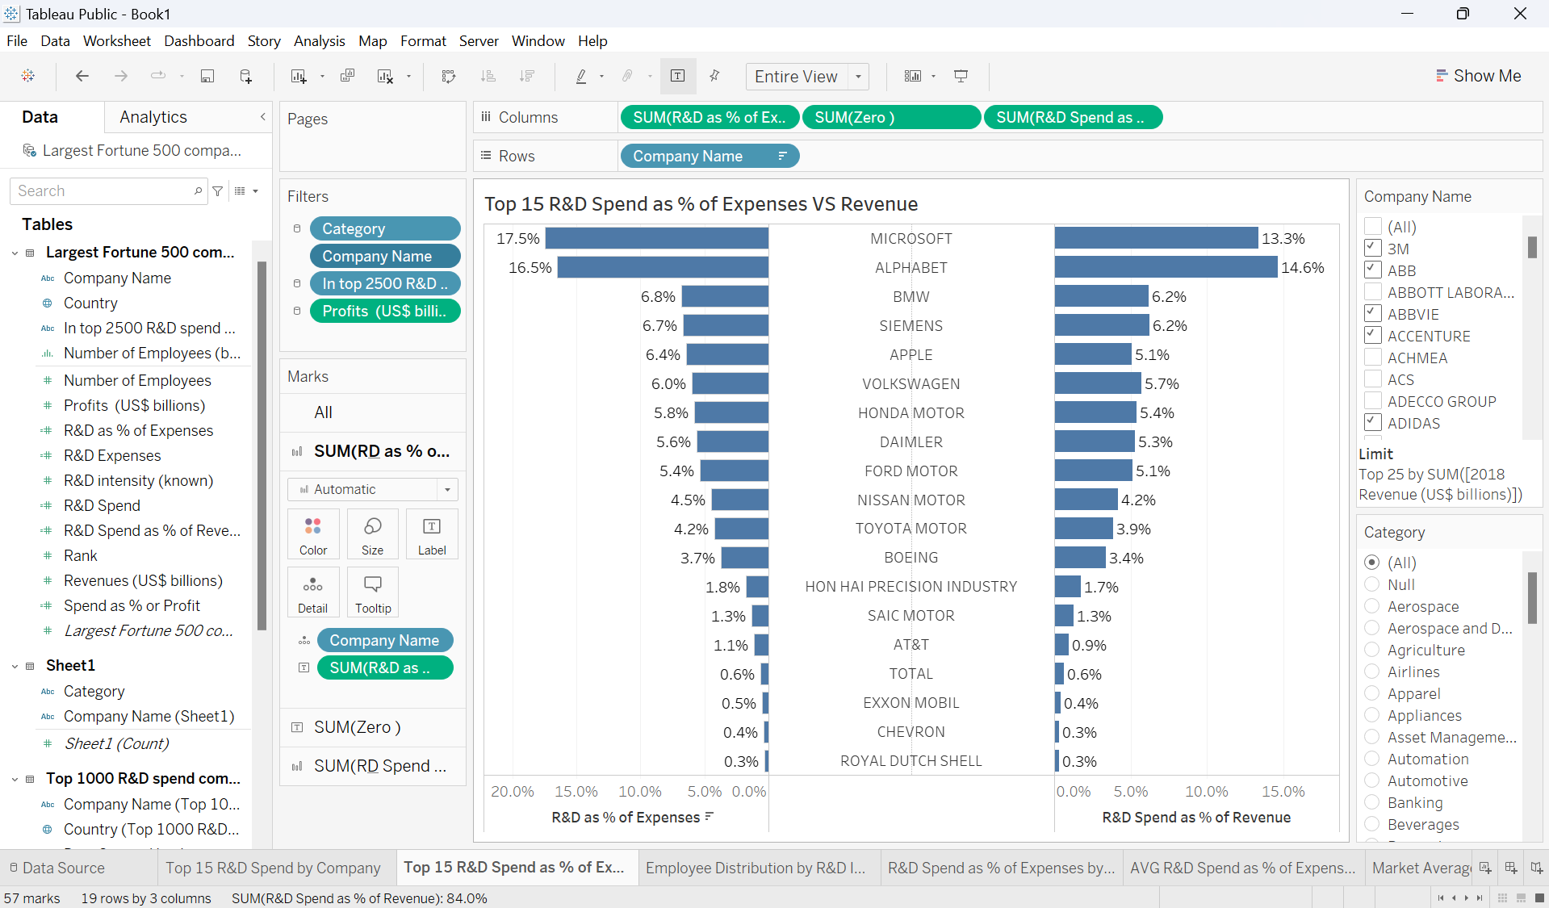

Insights
R&D spend as % of expenses increases with an increase in R&D spend as % of revenue
The best preforming companies spend more than %& of their expenses and revenue on R&D

Slide 5
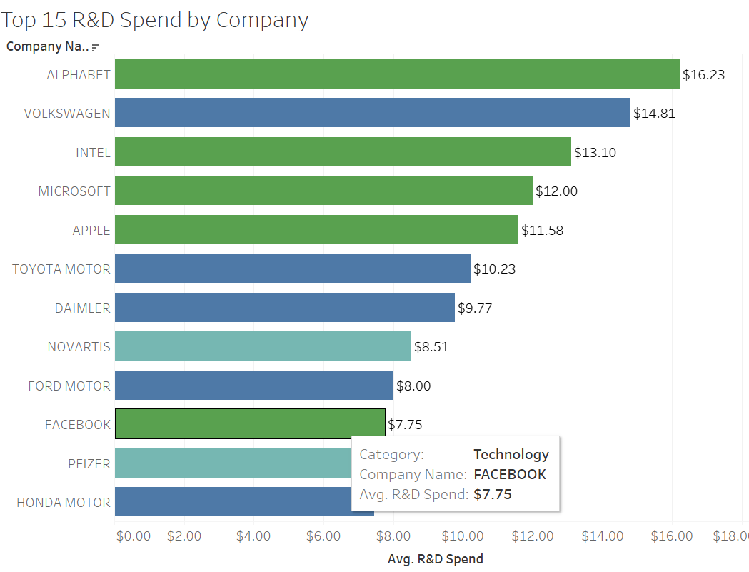
Alphabet tops in the R&D spend by company at $16.23 billion
This is followed by Volkswagen, Intel, and Microsoft

Slide 6
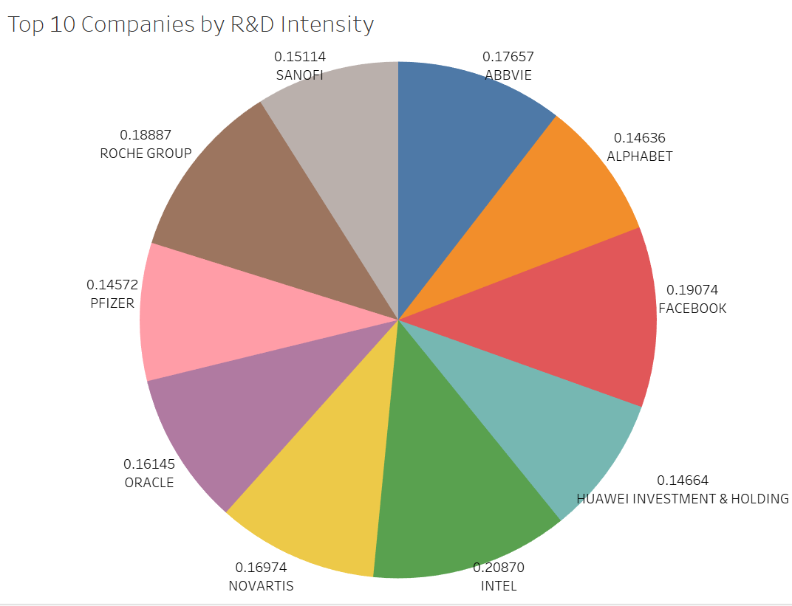
R&D Intensity
R&D intensity among top 10 companies ranges between 0.14% to 0.21%

Slide 7
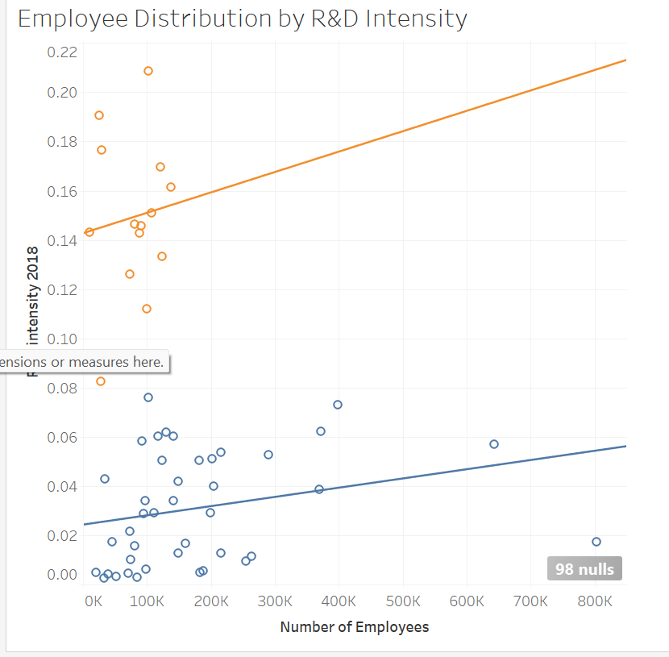
Companies with the high levels of R&D spend have the least number of employees.

Slide 8
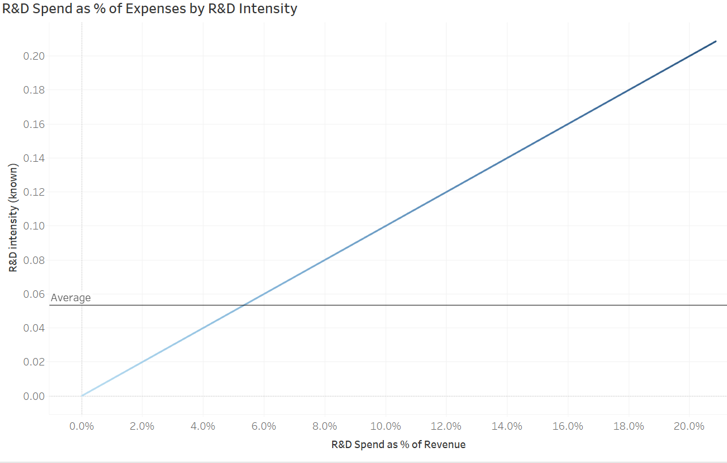
The higher the R&D spend as & of revenue, the higher the R&D spend intensity.

Slide 9
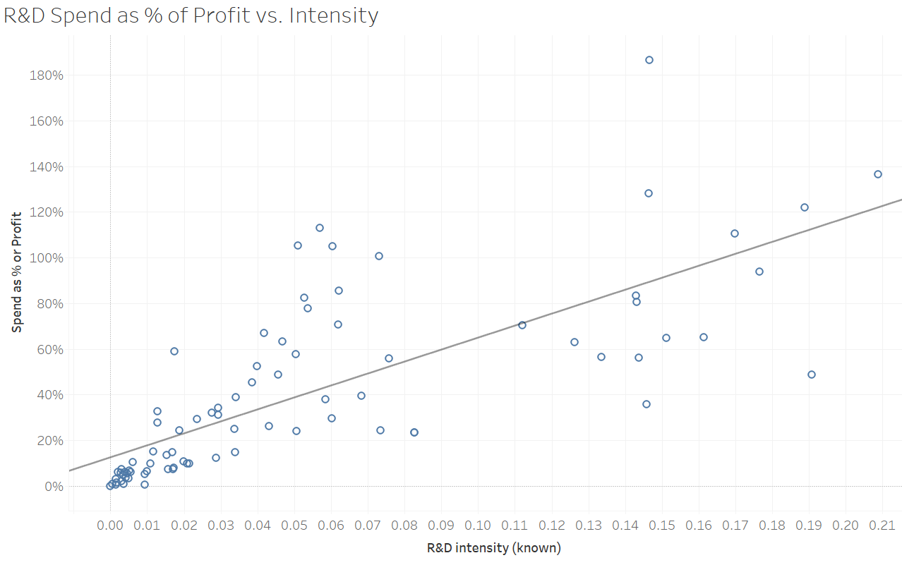
The higher the spend as % of profit, the higher the R&D intensity

Slide 10
Recommendations
Increase on R&D intensity to save on employee costs
Ensure a balance between R&D spend as % of expenses and R&D spend as % of revenue to achieve optimal R&D spend
Gradually increase R&D spending as a percentage of revenue

Slide 11
CTA
Develop a long-term R&D investment strategy that gradually increases the R&D spending as a percentage of revenue.
Invest in automation and technology-driven R&D processes to enhance efficiency and reduce the need for a large workforce.

Slide 12
THANK YOU!

